Slide 1
Predictive Analytics SPSS Modeler
• The importance of analytics and how its transforming the world today
• Understand how analytics provided a solution to industries using real case studies
• Explain what is analytics, the various types of analytics, and how to apply it
• Improve efficiency, sample records, and work with sequence data
• Explain data transformations, and functions
• Understand modeling, relationships, derive and reclassify fields
• Integrate and collect data
• Understand the principles of data mining
• Use the user interface of modeler to create basic program streams
• Read a statistics data file into modeler and define data characteristics
• Review and explore data to look at data distributions and to identify data problems, including missing values
• Use the automated data prep node to further prepare data for modeling
• User a partition node to create training and testing data subsets

Slide 2
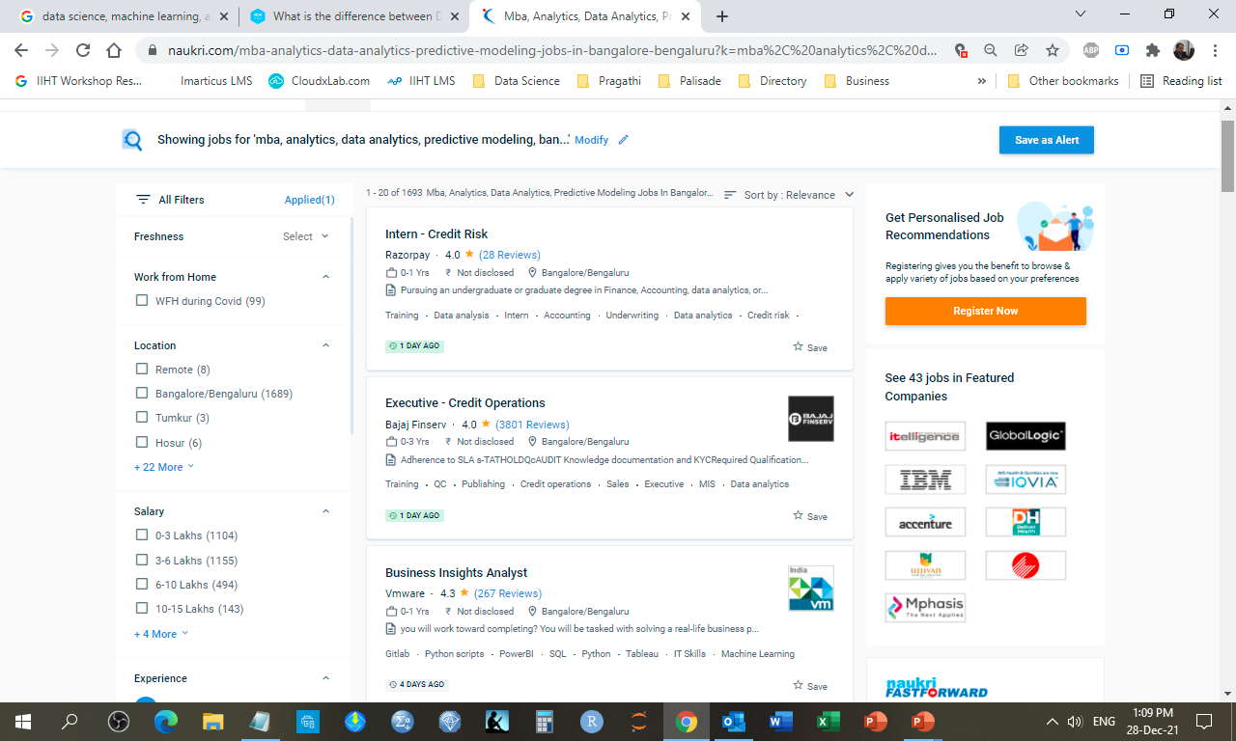
https://www.naukri.com/mba-analytics-data-analytics-predictive-modeling-jobs-in-bangalore-bengaluru?k=mba%2C%20analytics%2C%20data%20analytics%2C%20predictive%20modeling&l=bangalore%2Fbengaluru&experience=0

Slide 3
MODULE I – ANALYTICS OVERVIEW

Slide 4
Unit 1. Analytics overview Duration: 10 minutes
Overview This unit provides an understanding of the importance of business analytics in our world,
society, and life.
Learning objectives After completing this unit, you should be able to:
• Understand how analytics is transforming the world
• Understand the profound impact of analytics in business decisions
• Understand what is analytics and how it works
• Understand why business analytics has become important in various industries

Slide 5
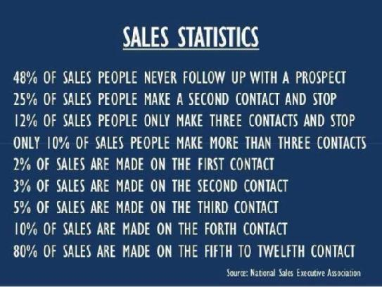

Slide 6
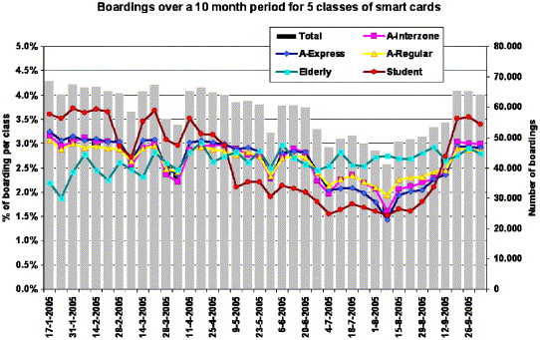

Slide 7
Business intelligence is the process of collecting, storing and analyzing data from business operations. BI provides comprehensive business metrics, in near-real time, to support better decision making. You can create performance benchmarks, spot market trends, increase compliance, and improve almost every aspect of your business with better business intelligence
Business analytics (BA) refers to the practice of using your company’s data to anticipate trends and outcomes. BA includes data mining, statistical analysis, and predictive modeling that help make more informed decisions. Data analytics is the technical process of mining data, cleaning data, transforming data, and building the systems to manage data. Data analytics takes large quantities of data to find trends and solve problems. Data analytics is used across disciplines—from government to science. It’s not just confined to business applications.
Machine learning is a way of programming an algorithm to predict or act in a way we want, without providing rules that the algorithm should follow. Instead, we provide data and desired response and we leave it to a computer to learn these rules by itself from provided examples.
Data science is a field of study that aims to use a scientific approach to extract meaning and insights from data. Dr. Thomas Miller of Northwestern University describes data science as “a combination of information technology, modeling, and business management”. Universities have acknowledged the importance of the data science field and have created online data science graduate programs.
Machine learning, on the other hand, refers to a group of techniques used by data scientists that allow computers to learn from data. These techniques produce results that perform well without programming explicit rules.

Slide 8
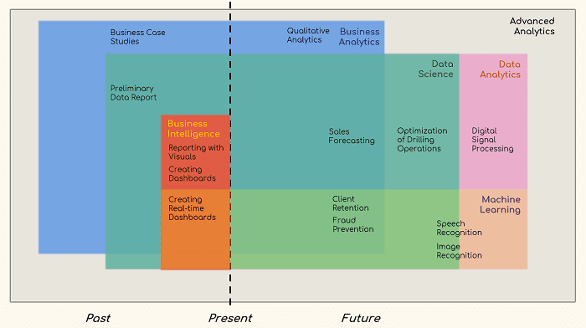

Slide 9
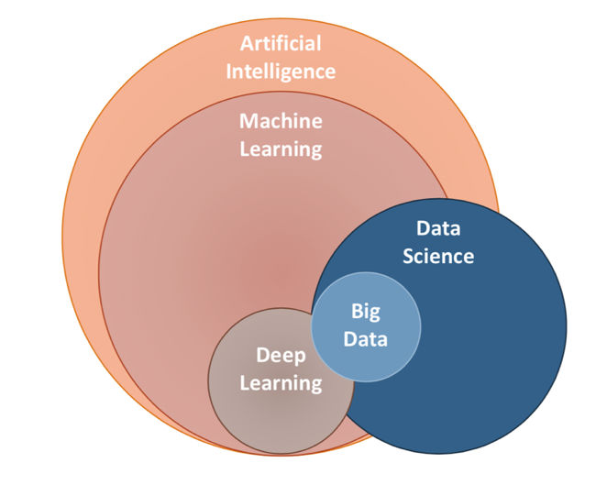

Slide 10
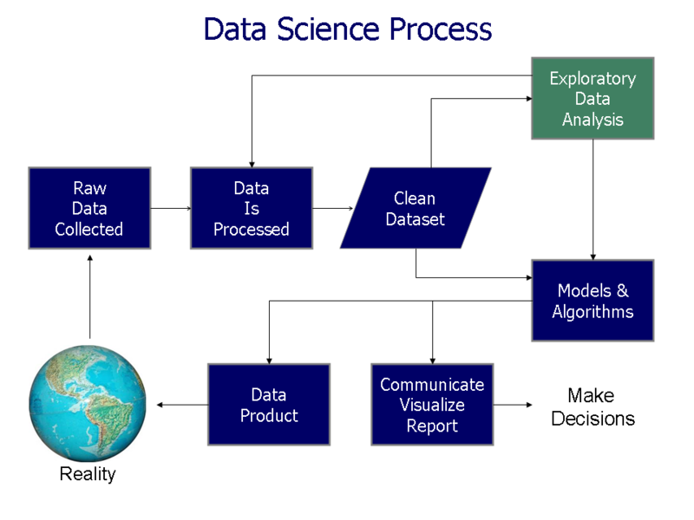

Slide 11
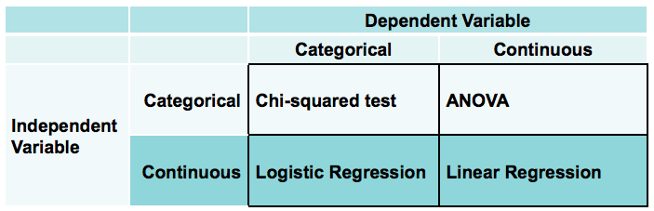

Slide 12
Unit 2. Analytics trends: Past, present & future Duration: 15 minutes
Overview This unit explains how analytics has evolved over time.
Learning objectives After completing this unit, you should be able to:
• Understand the history of analytics and how it has changed today
• Understand how to analyze unstructured data
• Understand how analytics is making the world smarter
• Understand where the future of analytics lies

Slide 13
Unit 3. Towards a predictive enterprise Duration: 5 minutes
Overview This unit explains the effects of business analytics in the corporate world that has led to its global adoption across geographies and industries.
Learning objectives After completing this unit, you should be able to:
• Explain why successful enterprises need business analytics
• Understand how business analytics can help turn data into insight

Slide 14
Unit 4. Analytics: Industry domains Duration: 5 minutes
Overview This unit highlights the application of analytics across major industries.
Learning objectives After completing this unit, you should be able to:
• Understand how predictive analytics is transforming all types of organizati• Explain how analytics supports retail companies
• Understand how analytics can reduce crime rates and accidents
• Explain the use of analytics in law enforcement and insurance companies• Understand how analytics can affect the future of education

Slide 15
Unit 5. Case studies and solutions Duration: 15 minutes
Overview This unit covers real case studies and solutions of the adoption of business analytics across the world.
Learning objectives After completing this unit, you should be able to:
• Understand the importance of business analytics
• Comprehend how big data and analytics can help in understanding consumer/customer behavior
• Explain how analytics can help manage assets
• Understand how analytics can help combat fraud
• Explain how analytics can help us to understand social sentiments

Slide 16
Business Intelligence and Analytics 101 Duration: 1 hour
Overview This course provides a collection of resources designed for participants to become familiar with business intelligence (BI) and analytics concepts. Participants will review materials to introduce themselves to terminology and practical business use cases for a high level understanding of BI and analytics. The course includes a pre-assessment for participants to measure their understanding of the content before taking the course, and a post-assessment for participants to gauge their learning after reviewing the materials.
Learning objectives After completing this course, you should be able to:
• Explain what is analytics
• Define various types of analytics
• Demonstrate how to apply analytics
• Describe business intelligence
• Demonstrate how to apply business intelligence

Slide 17
MODULE III – PREDICTIVE ANALYTICS MODELER

Slide 18
Unit 1. Introduction to data mining Duration: 1 hour
Overview In this unit, you will learn about data mining and its applications.
Learning objectives After completing this unit, you should be able to:
• List two applications of data mining
• Explain the stages of the CRISP-DM process model
• Describe successful data-mining projects and the reasons why projects fail
• Describe the skills needed for data mining

Slide 19
Unit 2. Working with modeler Duration: 1 hour
Overview In this exercise, you will learn about objects such as streams and nodes and you will acquire experience with the software.
Learning objectives After completing this exercise, you should be able to:
• Describe the MODELER user-interface
• Work with nodes
• Run a stream or a part of a stream
• Open and save a stream
• Use the online Help

Slide 20
Exercise 2. Working with modeler Duration: 45 minutes
Overview In this exercise, you will learn about MODELER’s user-interface to create streams.
Learning objectives After completing this exercise, you should be able to:
• Create streams
• Change streams
• Generate a select node from the Table output

Slide 21
Exercise 3. Working with modeler (workshop) Duration: 1 hour
Overview In this exercise, you will learn how to build and run streams.
Learning objectives After completing this exercise, you should be able to:
• Create a stream that reads data and exports data to Microsoft Excel
• Change and save a stream.
• Create a new stream from an existing stream.
• Make a stream neat using a SuperNode

Slide 22
Unit 3. A Data-mining tour Duration: 1 hour
Overview In this unit you will learn about building a model and then applying that model to future cases of a data-mining project.
Learning objectives After completing this unit, you should be able to:
• Explain the basic framework of a data-mining project
• Build a model
• Deploy a model

Slide 23
Exercise 4. A Data-mining tour Duration: 45 minutes
Overview In this exercise, you are working as a data miner for a telecommunications firm and have to identify customers who are likely to churn.
Learning objectives After completing this exercise, you should be able to:
• Build a model using historical data
• Deploy the model

Slide 24
Exercise 5. A Data-mining tour (Workshop) Duration: 1 hour
Overview In this exercise, you will learn to build a model using data of a test mailing and select groups with high response rates in the customer database.
Learning objectives After completing this unit, you should be able to:
• Explore the data
• Select modeling data
• Build a CHAID model
• Interpret of the fields added by model nugget
• Explore the results

Slide 25
Unit 4. Collecting initial data Duration: 1 hour
Overview In this exercise, you will learn how to collect initial data. You will also learn how to describe data.
Learning objectives After completing this exercise, you should be able to:
• Explain the concepts of data structure, unit of analysis, field storage and field
measurement level
• Import Microsoft Excel files
• Import text files
• Import from databases
• Export data to various formats

Slide 26
Exercise 6. Collecting initial data Duration: 45 minutes
Overview In this exercise you will learn how to import data from various data sources and report on the unit of analysis and fields’ measurement levels.
Learning objectives After completing this exercise, you should be able to:
• Import a Microsoft Excel file
• Import a text file
• Set fields’ measurement levels

Slide 27
Exercise 7. Collecting initial data (workshop) Duration: 1 hour
Overview In this exercise you are working for a company selling sports products. You will import the company’s data files and build a model to identify groups with high response rates.
Learning objectives After completing this exercise, you should be able to:
• Import data
• Determine the unit of analysis
• Determine relationships between datasets
• Set measurement levels

Slide 28
Unit 5. Understanding your data Duration: 1 hour
Overview In this exercise, you will learn how to explore data and assess it’s quality.
Learning objectives After completing this exercise, you should be able to:
• Audit the data
• Explain how to check for invalid values
• Take action for invalid values
• Explain how to define blanks

Slide 29
Exercise 8. Understanding your data Duration: 1 hour
Overview In this exercise, you will handle a case study where you will import data and later assess its quality.
Learning objectives After completing this exercise, you should be able to:
• Audit the data
• Define valid values and take action
• Declare blank values

Slide 30
Exercise 9. Understanding your data (Workshop) Duration: 1 hour
Overview In this unit, you will learn how to examine a company’s datasets, and take corrective action where needed.
Learning objectives After completing this unit, you should be able to:
• Explore the data
• Set ranges and take action
• Declare blanks

Slide 31
Unit 6. Setting the unit of analysis Duration: 1 hour
Overview In this exercise, you will learn how to set unit of analysis in three different methods.
Learning objectives After completing this exercise, you should be able to:
• Set the unit of analysis by removing duplicate records
• Set the unit of analysis by aggregating records
• Set the unit of analysis by expanding a categorical field into a series of flag fields

Slide 32
Exercise 10. Setting the unit of analysis Duration: 45 minutes
Overview In this exercise, you will learn how to remove duplicate records from a customer dataset. You will also learn how to transform a transactional dataset into a dataset that has one record per customer.
Learning objectives After completing this exercise, you should be able to:
• Cleanse data by removing duplicate records
• Expand a categorical field into a series of flag fields

Slide 33
Exercise 11. Setting the unit of analysis (Workshop) Duration: 1 hour
Overview In this exercise you will learn how to import data from several sources and create datasets withthe required unit of analysis.
Learning objectives After completing this exercise, you should be able to:
• Remove duplicate records
• Create a dataset where customers are unique in a company’s purchases data
• Create a dataset where customers are unique in a company’s order lines data
• Create a dataset where customers are unique in a company’s mailing history data

Slide 34
Unit 7. Integrating data Duration: 1 hour
Overview In this exercise you will learn how to combine different datasets into a single dataset for analysis.
Learning objectives After completing this exercise, you should be able to:
• Integrate data by appending records from multiple datasets
• Integrate data by merging fields from multiple datasets
• Sample records

Slide 35
Exercise 12. Integrating data Duration: 45 minutes
Overview In this exercise, you will learn how to combine a number of datasets into a single dataset as a preparation for analysis and modeling.
Learning objectives After completing this exercise, you should be able to:
• Append records from two datasets
• Merge fields from different datasets
• Enrich a dataset with aggregated data
• Sample records

Slide 36
Exercise 13. Integrating data (Workshop) Duration: 1 hour
Overview In this unit, you will learn how to combine a number of datasets into a single dataset to build models using the information from all these datasets.
Learning objectives After completing this unit, you should be able to:
• Create single datasets
• Enrich the data with zipcode information
• Export a random sample

Slide 37
Unit 8. Deriving and reclassifying fields Duration: 1 hour
Overview In this exercise you will learn how to construct the final dataset for modeling by cleansing and enriching your data.
Learning objectives After completing this exercise, you should be able to:
• Use the Control Language for Expression Manipulation (CLEM)
• Derive new fields
• Reclassify field values

Slide 38
Exercise 14. Deriving and reclassifying fields Duration: 45 minutes
Overview In this exercise, you will learn how to cleanse and enrich a dataset to build models.
Learning objectives After completing this exercise, you should be able to:
• Cleanse data and derive fields for modeling
• Cleanse data and reclassify fields for modeling

Slide 39
Exercise 15. Deriving and reclassifying fields (Workshop) Duration: 1 hour
Overview In this exercise, you will learn how to cleanse a company’s data and enrich the data with a number of new fields so that better models can be built.
Learning objectives After completing this exercise, you should be able to:
• Compute the difference between amount spent and credit limit
• Compute fields in a currency from a different currency
• Create a segment field
• Create a field returning the bonus

Slide 40
Unit 9. Looking for relationships Duration: 1 hour
Overview In this exercise you will learn methods used to examine the relationship between two fields.
Learning objectives After completing this exercise, you should be able to:
• Examine the relationship between two categorical fields
• Examine the relationship between a categorical field and a continuous field
• Examine the relationship between two continuous fields

Slide 41
Exercise 16. Looking for relationships Duration: 45 minutes
Overview In this exercise you will learn how to assess relationships and determine its strength by doing ademo.
Learning objectives After completing this exercise, you should be able to:
• Assess the relationship between churn and handset
• Assess the relationship between churn and number of dropped calls
• Assess the relationship between number of products and revenues

Slide 42
Exercise 17. Looking for relationships (Workshop) Duration: 1 hour
Overview In this unit, you will learn how to examine the relationships in datasets and find out which fields are related to response.
Learning objectives After completing this unit, you should be able to:
• Examine the relationship between response and other factors in the dataset.

Slide 43
Unit 10. Introduction to modeling Duration: 1 hour
Overview In this exercise, you will learn about the modeling stage of the CRISP-DM process model.
Learning objectives After completing this exercise, you should be able to:
• List three modeling objectives
• Use a classification model
• Use a segmentation model

Slide 44
Exercise 18. Introduction to modeling Duration: 45 minutes
Overview In this exercise you will learn about classification and segmentation using a synthetic dataset from a telecommunications firm.
Learning objectives After completing this exercise, you should be able to:
• Predict churn by running a CHAID model
• Predict churn by running a Neural Net model
• Compare the accuracy of these models
• Find groups of similar customers, based on usage.

Slide 45
Exercise 19. Introduction to modeling (Workshop) Duration: 1 hour
Overview In this exercise, you will learn how to check a model’s accuracy and use segmentation to cluster records.
Learning objectives After completing this exercise, you should be able to:
• Build a CHAID model to predict response
• Assess the model’s accuracy
• Apply the model to other customers
• Use the two step segmentation model to cluster records

Slide 46
Course II – Advanced data preparation
Duration: 13.75 hours

Slide 47
Unit 1. Using functions Duration: 1 hour
Overview In this unit, you will learn how to use various different kinds of functions.
Learning objectives After completing this unit, you should be able to:
• Use date functions
• Use conversion functions
• Use string functions
• Use statistical functions
• Use missing value functions

Slide 48
Exercise 1. Using functions Duration: 30 minutes
Overview In this exercise, you will learn how to use functions to cleanse and enrich a dataset to build better models.
Learning objectives After completing this exercise, you should be able to:
• Use the date functions to derive fields
• Use string functions to derive fields
• Use statistical functions to derive fields
• Use missing value functions to derive fields

Slide 49
Exercise 2. Using functions (Workshop) Duration: 1 hour
Overview In this exercise, you will work with data based on customers and their holiday destinations. You will then use this data to answer questions.
Learning objectives After completing this exercise, you should be able to:
• Import and instantiate the data
• Compute an AGE field
• Conditionally compute the sum over a series of fields
• Derive a field taking blank values into account

Slide 50
Unit 2. Data transformations Duration: 1 hour
Overview In this exercise, you will learn how to apply various different nodes to modify fields and prepare your data for modeling.
Learning objectives After completing this exercise, you should be able to:
• Use the Filler node to replace values
• Use the Binning node to recode continuous fields
• Use the Transform node to change a field’s distribution

Slide 51
Exercise 3. Data transformations Duration: 1 hour
Overview In this exercise, you will learn how to cleanse data using the Filler node and add new fields using the Binning node and the Transform node.
Learning objectives After completing this exercise, you should be able to:
• Use the Filler node to change storage
• Use the Filler node to replace null values
• Use the Filler node to replace strings
• Do binning with equal counts
• Do binning using a supervisor field

Slide 52
Exercise 4. Data transformations (Workshop) Duration: 1 hour
Overview In this unit, you will learn how to transform data by importing, replacing and recoding. Learning objectives After completing this unit, you should be able to:
• Import and instantiate the data
• Correct spelling
• Replace blanks with undefined values
• Bin a field optimally with respect to target
• Transform a field to change its distribution

Slide 53
Unit 3. Working with sequence data Duration: 1 hour
Overview In this exercise, you will learn how to work with sequenced data.
Learning objectives After completing this exercise, you should be able to:
• Use cross-record functions
• Use the Count mode in the Derive node
• Use the Restructure node to expand a continuous field into a series of continuous fields
• Use the Space-Time-Boxes node to work with geospatial and time data

Slide 54
Exercise 5. Working with sequence data Duration: 45 minutes
Overview In this exercise, you will learn how to apply various transformations to sequence data.
Learning objectives After completing this exercise, you should be able to:
• Create a record identifier
• Move an average
• Restructure a transactional dataset
• Use the Space-Time-Boxes node

Slide 55
Exercise 6. Working with sequence data (Workshop) Duration: 1 hour
Overview In this exercise, you will learn how to work on a dataset, and derive new fields.
Learning objectives After completing this exercise, you should be able to:
• Import the data
• Derive a record identifier
• Restructure the dataset
• Analyze geospatial and time data

Slide 56
Unit 4. Sampling records Duration: 1 hour
Overview In this exercise, you will learn how to use the Sample node and various reasons for sampling records.
Learning objectives After completing this exercise, you should be able to:
• Use the Sample node to draw simple and complex samples
• Partition the data into a training and a testing set
• Reduce or boost the number of records

Slide 57
Exercise 7. Sampling records Duration: 45 minutes
Overview In this exercise, you will learn how sample data using various techniques, and use partitioning to select the best predictive model.
Learning objectives After completing this exercise, you should be able to:
• Draw a simple sample and a complex sample
• Partition data into a training set and a testing set
• Balance the data

Slide 58
Exercise 8. Sampling records Duration: 1 hour
Overview In this exercise, you will learn how to sample a data for a satisfaction survey and build a model to predict response to a campaign.
Learning objectives After completing this exercise, you should be able to:
• Import the data, instantiate the data and examine the response
• Draw a random sample
• Draw a stratified sample
• Prepare for modeling by using a Type node
• Run models on the training set and select the best model

Slide 59
Unit 5. Improving efficiency Duration: 1 hour
Overview In this exercise, you will learn how to work with SQL pushback, Set Globals node and parameters to optimize efficiency.
Learning objectives After completing this exercise, you should be able to:
• Use database scalability by SQL pushback
• Use the Data Audit node to process outliers and missing values
• Use the Set Globals node
• Use parameters
• Use looping and conditional execution

Slide 60
Exercise 9. Improving efficiency Duration: 45 minutes
Overview In this exercise, you will learn how to check data for outliers and extremes, compute standardized scores and use parameters and looping.
Learning objectives After completing this exercise, you should be able to:
• Use the Data Audit node to process outliers, extremes and missing values
• Compute standardized scores using globals
• Use parameters
• Create a loop through values

Slide 61
Exercise 10. Improving efficiency (Workshop) Duration: 1 hour
Overview In this exercise, you will learn how to process outliers, extremes and missing values using the Data Audit node. You will use the Set Globals node to replace missing values, and will be introduced to automation by using parameters and looping.
Learning objectives After completing this exercise, you should be able to:
• Import and instantiate the data
• Use globals to replace undefined values with the mean
• Create a loop through the row fields in the Matrix node

Slide 62
Course III – Automated Data Mining
Duration: 14.8 hours

Slide 63
Unit 1. Introduction to data mining Duration: 45minutes
Overview In this unit you will learn about the principles of data mining.
Learning objectives After completing this unit, you should be able to:
• Describe the featured included with modeler to automate data mining
• Describe the phases of the CRISP-DM process model for data mining

Slide 64
Unit 2. The basics of using a modeler Duration: 1 hour
Overview In this unit you will review the basic features of the modeler user interface and learn how to perform common actions.
Learning objectives After completing this unit, you should be able to:
• Use the modeler interface
• Describe the components of the modeler user interface
• Place nodes on the stream canvas
• Connect and disconnect nodes
• Edit and rename codes

Slide 65
Exercise 1. Adding nodes and creating streams in the modeler Duration: 15 minutes
Overview In this exercise, you will learn how to create adding nodes, and streams in modeler.
Learning objectives After completing this exercise, you should be able to:
• Create nodes
• Create streams

Slide 66
Unit 3. Reading data files Duration: 1 hour
Overview In this unit you will learn how to read data files and define data characteristics.
Learning objectives After completing this unit, you should be able to:
• Read a statistics data file into modeler
• Use a statistics file node to read a statistics data file
• Use the filter tab to filter and rename fields
• Use the types tab to view measurement level and set field role
• Save a modeler stream file

Slide 67
Exercise 2. Reading a data file and typing the data in the source node Duration: 20 minutes
Overview In this exercise, you will learn how to read a data file and type the data in the source node.
Learning objectives After completing this exercise, you should be able to:
• Read a data file
• Type the data in the source node

Slide 68
Unit 4. Data exploration Duration: 1 hour
Overview In this unit you will learn about different issues concerned with data quality.
Learning objectives After completing this unit, you should be able to:
• Review and explore data to look at data distributions
• Identify data problems, including missing values
• Describe the types of missing values for fields
• Set missing values for fields
• Use the data audit node to explore data distributions
• Use the data audit node to impute missing data
• Use the table node to view the data file

Slide 69
Exercise 3. Review missing values in modeler and use the data audit node on the charity data Duration: 30 minutes
Overview In this exercise, you will learn how to review missing values in the modeler, and to use the data audit node on the charity data.
Learning objectives After completing this exercise, you should be able to:
• Edit the source node
• Identify what types of blank values are defined for fields
• Add a data audit node to the stead
• Review missing values

Slide 70
Unit 5. Automated data preparation Duration: 1 hour
Overview In this unit you will learn how to apply automated data preparation to the telecommunications customer data to continue the process of data preparation.
Learning objectives After completing this unit, you should be able to:
• Use the automated data prep node to further prepare data modeling
• Use the type node to set characteristics for fields
• Describe the various features and capabilities of the automated data prep node
• Use settings of the automated data prep node that are appropriate for the data and
modeling objectives
• Describe the types of output produced by the automated data prep node

Slide 71
Exercise 4. Practice using the ADP node to prepare data for modeling Duration: 20 minutes
Overview In this exercise, you will learn how to use the ADP node to prepare data for modeling.
Learning objectives After completing this exercise, you should be able to:
• Add an ADP node to the stream
• Edit the ADP node
• Run analysis on the ADP node

Slide 72
Unit 6. Data partitioning Duration: 45 minutes
Overview In this unit you will learn how to add a partition node to the stream.
Learning objectives After completing this unit, you should be able to:
• Use a partition node to create training and testing data subsets
• Describe rationale and use of a partition node to create data subsets
• Set sizes of the training and testing partitions and other partition characteristics
• Use a distribution node to view the distribution of a categorical field

Slide 73
Exercise 5. Use a partition node to split the charity data for modeling Duration: 20 minutes
Overview In this exercise, you will learn how to create training and testing partitions.
Learning objectives After completing this exercise, you should be able to:
• Use a partition node to create training and testing data subsets
• Describe rationale and use of a partition node to create data subsets
• Set sizes of the training and testing partitions
• Use a distribution node to view the distribution of a categorical field

Slide 74
Unit 7. Predictor selection for modeling Duration: 1 hour
Overview In this unit you will learn about the feature selection node and how it can help in data modeling.
Learning objectives After completing this unit, you should be able to:
• Use the feature selection node to select inputs for modeling
• Describe the features and settings of the feature selection node
• Describe the model output from feature selection
• Generate a filter node to use the selected fields

Slide 75
Exercise 6. Use the feature selection node to select fields and predict a response Duration: 20 minutes
Overview In this exercise, you will use the feature selection node to select fields and predict a response.
Learning objectives After completing this exercise, you should be able to:
• Use the feature selection node to select fields
• Predict a response

Slide 76
Unit 8. Automated models for categorical targets Duration: 1 hour
Overview In this unit you will learn how to use the auto classifier node to create an ensemble model that predicts a categorical target.
Learning objectives After completing this unit, you should be able to:
• Describe the features and settings of the auto classifier node
• Describe and use the components of the model output from the auto classifier node

Slide 77
Exercise 7. Using the auto classifier node to construct a model in order to predict a response Duration: 20 minutes
Overview In this exercise, you will learn how to use the auto classifier node to construct a model in order to predict a response.
Learning objectives After completing this exercise, you should be able to:
• Use the auto classifier node to construct a model in order to predict a response

Slide 78
Unit 9. Model evaluation Duration: 1 hour
Overview In this unit, you will learn how to evaluate and understand the predictions of a model.
Learning objectives After completing this unit, you should be able to:
• Use the analysis mode to get a summary of predictions
• Use the select node to analyze the testing partition data
• Use a matrix node to examine the percent accuracy of predictions
• Use a distribution node to graphically display the relationship between a categorical
prediction and the target
• Use a histogram node to graphically display the relationship between a continuous
predictor and the target

Slide 79
Exercise 8. Evaluate the model created to predict the field response Duration: 30 minutes
Overview In this exercise, you will learn how to evaluate the model created in order to predict the field response.
Learning objectives After completing this exercise, you should be able to:
• Use an analysis node to evaluate model predictions
• Use a distribution node to evaluate model predictions
• Use a histogram node to evaluate model predictions

Slide 80
Unit 10. Automated models for continuous targets Duration: 1 hour
Overview In this unit you will learn how to use the auto numeric node to create an ensemble model to predict a continuous target.
Learning objectives After completing this unit, you should be able to:
• Describe and use the features of the auto numeric node
• Describe and use the components of the model output from the auto numeric node
• Use various nodes for model evaluation

Slide 81
Exercise 9. Develop a model to predict the total spending Duration: 30 minutes
Overview In this exercise, you will learn how to develop a model to predict total spending by the
respondent.
Learning objectives After completing this exercise, you should be able to:
• Add an auto numeric node to the stream
• Use an analysis node to evaluate the auto numeric model

Slide 82
Unit 10. Deploying models Duration: 50 minutes
Overview In this unit you will learn how to use a model to score new data.
Learning objectives After completing this unit, you should be able to:
• Describe what needs to be modified to create a scoring stream for new data
• Describe the deployment options in modeler
• Export scored data to another file format

Slide 83
Exercise 11. Use a scoring stream to make predictions Duration: 20 minutes
Overview In this exercise, you will learn how to use a scoring stream to make predictions.
Learning objectives After completing this exercise, you should be able to:
• Use a scoring stream to make predictions

Slide 84
Unit 12. Course summary Duration: 45 minutes
Overview In this unit you will learn how to use modeler to perform an automated data mining project.
Learning objectives After completing this unit, you should be able to:
• Understand the principles of data mining
• Use the user interface of modeler to create basic program streams
• Read a statistics data file into modeler and define data characteristics
• Review and explore data to look at data distributions and to identify data problems, including missing values
• Use the automated data prep node to further prepare data for modeling
• User a partition node to create training and testing data subsets
• Use the feature selection node to select inputs for modeling
• Use the auto classifier node to create an ensemble model to predict a continuous target
• Use a model to score new data

